Slide 1

Unbiased Multiple Instance Learning for Weakly Supervised Video Anomaly Detection
Paper review
Gibeom Kim (UST)
Notes:
i’m master’s degree student of prof.Hyejin kim.
I'm interested in the anomaly detection and I decided to review this paper because this model is often used as a base model of anomaly detection task.

Slide 2

Index
Paper abstract
1-1. Multiple Instance Learning (MIL)
Model
Conclusion
Notes:
I don't know how much you know about Padim, so I’ll explain a quick overview of the basics of Padim

Slide 3
1. Paper abstract
UMIL introduces an unbiased learning approach to address the context bias issue in traditional MIL.
The dataset is divided into two dataset: a confident set and an ambiguous set.
Also ambiguous set is clustered to two dataset.
During training, similar datasets are trained to produce similar outputs, while different snippets yield different outputs.
Notes:
i’ll explain detail about this content on later slide
전제: Premise

Slide 4
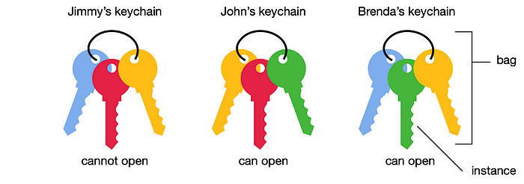
1-1. Multiple Instance Learning (MIL)
A type of weakly supervised learning algorithm
Training set consists of labeled "bags," each containing multiple "instances.
A bag is typically labeled positive if at least one instance in it is positive, and negative if all instances are negative
Train a model that can predict the labels of unseen bags

Slide 5
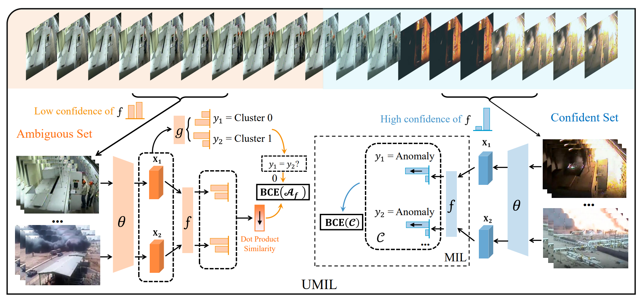
1. Paper Abstract

Slide 6
2. Model
Dataset preprocess
Make image data bags(=snippets) to train
Divide snippets to confidence set and ambiguous set by using anomaly head f

Slide 7
2. Model
Train with confidence set
Extract feature by using pretrained model(θ, e.g. Kinetics400)
Calculate the confidence of the snippets by using anomaly head
Update the model with binary cross entropy loss of confidence

Slide 8
2. Model
Train with ambiguous set
Divide snippets to two cluster by using cluster head g.
Extract feature by using pretrained model(θ, e.g. Kinetics400)
Calculate the confidence of the snippets by using anomaly head
Update the model with binary cross entropy loss of confidence

Slide 9
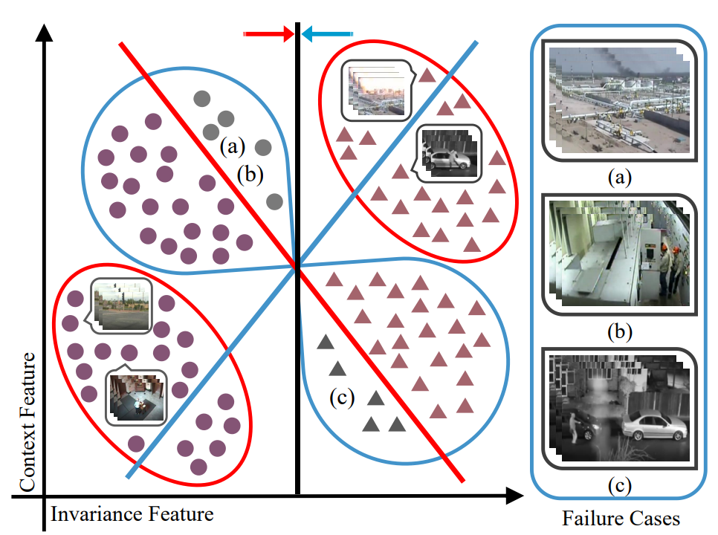
2. Model
Dataset preprocess
Make image data bags(=snippets) to train
Divide snippets to confidence set and ambiguous set

Slide 10
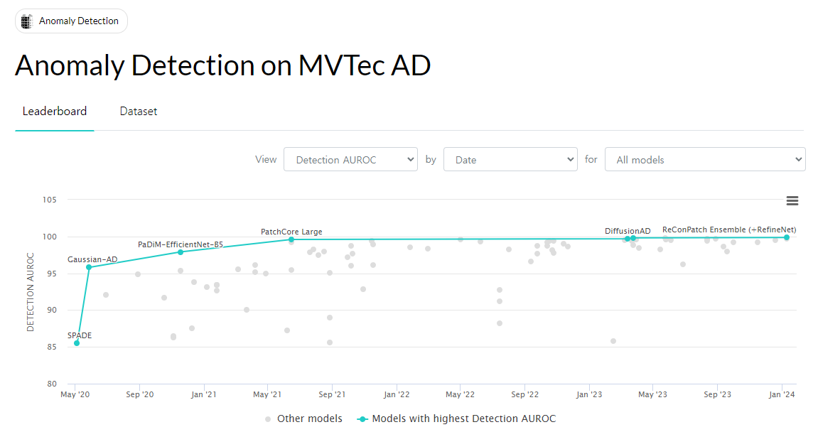
3. Conclusion
Notes:
So we can say that the PADIM model is very important in the anomaly detection task.

Slide 11
Thank you

